Slide 1
Future Sales Prediction with Machine Learning
Ridham Jain (700742608)
Sai Kiran Kalaganti (700744260)
Sai Kiran Reddy Kotha (700746206)
Shruthika Veeravarapu (700737920)

Slide 2
Role/Responsibilities and Contribution in project
Name | Responsibilities
Ridham Jain | Requirement Analysis. Necessary libraries and IDE tools to implement, required ML Techniques
SaiKiran Reddy Kotha | Project flow design. Project flow is designed and delegated the work to each team members
Sai Kiran Kalaganti | Data collection and cleaning. Data is collected from the GitHub repository and cleaned the data accordingly
Shruthika Veeravarapu | Data exploration ED. Analyzed data on different factors

Slide 3
Motivation
The motivation for future sales prediction with machine learning are:-
• Improved decision-making
• Use to optimize the operations
• Improve the marketing strategies
• Use to increase their profitability
• Help the businesses stay ahead of their competitors and adapt to changes in the market, ultimately leading to increased revenue and customer satisfaction

Slide 4
Objectives
The main objective for future sales prediction with machine learning is to:-
• Accurately predict future sales
• Improve inventory management
• Optimize marketing strategies
• Identify new business opportunities
• Enhance customer satisfaction
• Increase profitability

Slide 5
Related Work
The extreme Gradient Boosting Regressor (XGBRegressor) is a popular algorithm in machine learning, having been the winning algorithm in several Kaggle competitions.
In gradient boosting, multiple models are combined, and the gradient is used to optimize the boosted model prediction in each boosting round.
XGBoost is a special implementation of a gradient boosting machine that uses more accurate approximations to find the best model, and it improves upon gradient boosting through system optimization and algorithmic enhancements.
Linear regression is another ML algorithm used for supervised learning that finds a linear relationship between a dependent variable and the given independent variables.
In linear regression, the algorithm predicts a dependent variable based on the given independent variables.
Linear regression is a simple and widely used ML algorithm that can be used for both regression and classification problems.
Both XGBoost and linear regression are useful algorithms in machine learning that can be used for a variety of applications, depending on the data and the problem at hand.

Slide 6
Paper-2 Contribution: (Sai Kiran Kalaganti)
•The paper presents a machine learning-based approach for future sales prediction in a retail company
•Goal: to accurately predict future sales and improve inventory management and supply chain efficiency
•Describes data preprocessing and feature engineering techniques used to prepare the data for analysis. Various statistical techniques used to extract meaningful features from the data
•Compares the performance of various machine learning algorithms, including linear regression, decision tree, random forest, and neural networks. Cross-validation techniques used to evaluate the performance of each algorithm
•Results: neural networks outperformed other algorithms, with an accuracy of 89.6% in predicting future sales
•The paper concludes that machine learning techniques can effectively predict future sales in a retail company
•The authors recommend the use of neural networks for accurate and reliable sales predictions. The proposed approach can help retail companies improve their inventory management and supply chain efficiency, leading to cost savings and increased profitability.

Slide 7
Paper-4 Contribution:(Shruthika)
•Defining the problem of predicting sales as a regression task.
•Performing extensive data pre-processing, including handling missing values, encoding categorical variables, and scaling numerical features.
•Considering multiple machine learning algorithms and evaluating their performance on the dataset using metrics such as RMSE and R-squared.
•Using feature engineering techniques to select and transform relevant features for the models. Presenting the best-performing algorithm and its corresponding RMSE and R-squared values.
•Evaluating the model's performance and identifying potential areas for improvement.
•Summarizing the key findings of the analysis and their implications for sales prediction in retail.
•Discussing potential future work, such as incorporating external factors like weather and holidays into the model or using ensemble techniques for improved accuracy.

Slide 8
Problem Statement
The heated competition between various shopping malls and big-box stores is become more serious and intense as a result of the rapid expansion of international malls and internet shopping.
Every mall or store tries to give unique, limited-time deals to draw in more consumers based on the day so that the volume of sales for each item can be forecasted for inventory management of the company, logistics and transportation service.
Most of the business organizations heavily depend on a knowledge base and demand prediction of sales trends.

Slide 9
Proposed Solution
The competition between shopping malls and big-box stores is becoming more intense due to the rapid expansion of international malls and online shopping.
Retailers need to forecast sales trends and manage inventory based on unique, limited-time deals to draw in more consumers.
Data analytics and machine learning algorithms can be used to analyze past sales data, personalize marketing strategies, optimize logistics and transportation, and create a positive shopping experience.
Innovation and collaboration between retailers and mall operators can help to stay ahead of the competition and offer customers unique and engaging experiences.

Slide 10
Implementation
We have implemented six regression models to predict the future sales:
Linear regression model
Decision tree regression model
Random forest regression model
Support vector regression model
K-nearest neighbor regression model
Gradient boosting regression model

Slide 11
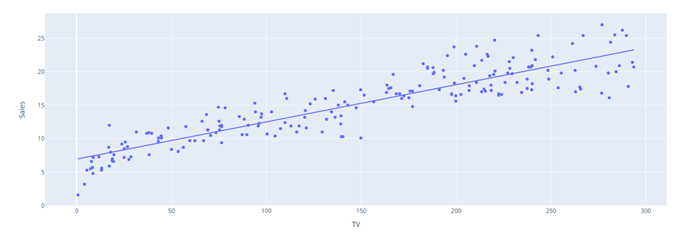
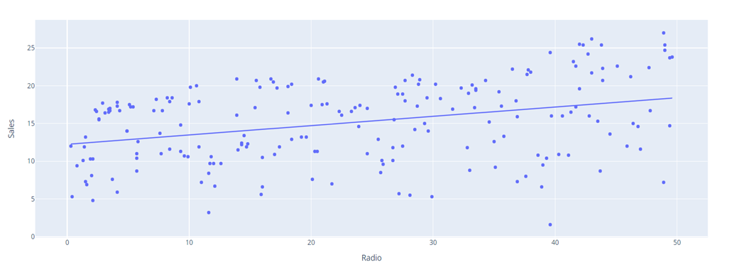

Slide 12
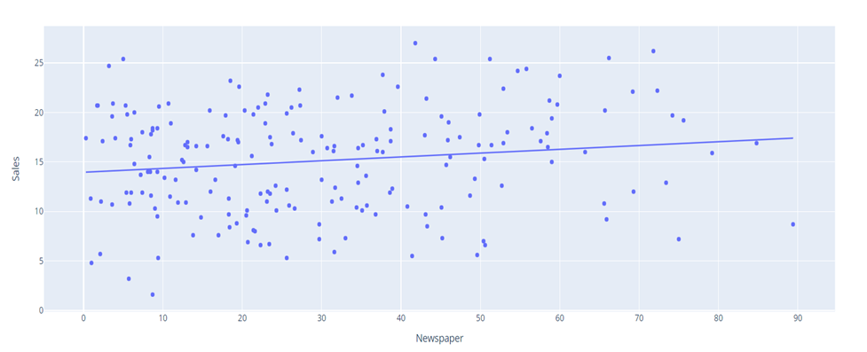
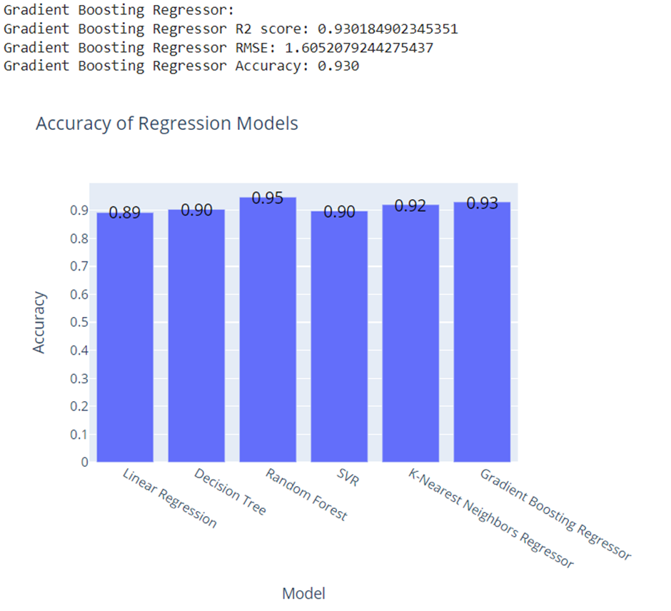

Slide 13
Results
Data analysis techniques such as scatterplots and correlation coefficients were used to analyze the relationship between various modes of advertisement and sales.
The data was split into training and testing subsets to develop and evaluate regression models.
Different types of regression models were trained and evaluated including linear regression, decision tree regression, random forest regression, support vector regression, and k-nearest regression.
The accuracy of each regression model was evaluated to determine which model performed the best.
A bar graph was plotted to compare the accuracy of each regression model.

Slide 14
References
D. K. Yadav and N. R. Jagdale, "Future Sales Prediction Using Machine Learning Techniques," International Journal of Creative Research Thoughts, vol. 9, no. 1, pp. 827-829, Jan. 2021. https://www.ijcrt.org/papers/IJCRT2103184.pdf
P. Sharma, S. Khater and V. Vashisht, "Sales Forecast of Manufacturing Companies using Machine Learning navigating the Pandemic like COVID-19," 2021 2nd International Conference on Computation, Automation and Knowledge Management (ICCAKM), Dubai, United Arab Emirates, 2021, pp. 1-5, doi: 10.1109/ICCAKM50778.2021.9357751. https://ieeexplore.ieee.org/document/9357751
INTELLIGENT SALES PREDICTION USING MACHINE LEARNING IJRECE VOL. 7 ISSUE 4 2019 ISSN: 2393-9028 | ISSN: 2348-2281 https://nebula.wsimg.com/9c57886ee8e628af1879d9497f1b379f?AccessKeyId=DFB1BA3CED7E7997D5B1&disposition=0&alloworigin=1
R. P and S. M, "Predictive Analysis for Big Mart Sales Using Machine Learning Algorithms," 2021 5th International Conference on Intelligent Computing and Control Systems (ICICCS), Madurai, India, 2021, pp. 1416-1421, doi: 10.1109/ICICCS51141.2021.9432109. https://ieeexplore.ieee.org/document/9432109

